Slide 1
MVP Presentation INSPIRA
Idea Title : AI-Powered Skin Health Companion for Indian Patients
Team Captain Name : Rajaganapathi M
Team members Names : Divyasri M, Pradeep SA, Nivethika P
College Name :Kalaingnar Karunanidhi Institute of Technology

Slide 2
Problem Statement & Solution Description
Problem Statement
Solution Description
India faces a severe dermatologist shortage — only 1 dermatologist per 100,000 people in rural areas. Over 180 million Indians suffer from skin conditions like acne, yet most lack access to timely diagnosis and follow-up care.
Key problems:
Patients wait weeks for dermatologist appointments, worsening conditions
Language barriers prevent rural patients from understanding medical advice (Hindi, Tamil speakers)
No continuity of care — patients get one consultation but no daily monitoring
Sharing medical records with doctors is insecure and cumbersome
Patients self-medicate without proper guidance, leading to complications
Impact: Delayed treatment leads to scarring, infection, mental health issues, and increased healthcare costs. 60% of acne patients in India don't seek treatment due to access barriers.
MediBot is an AI-powered skin health companion that provides end-to-end patient care using AWS Bedrock (Claude AI):
AI Triage — Patient uploads a skin photo or describes symptoms in Hindi/Tamil/English. Claude AI analyzes and returns severity assessment with confidence score.
Smart Guidance — For low/medium severity: AI generates personalized home remedies and precautions in the patient's language. For high severity: immediate dermatologist booking.
Appointment Booking — One-click booking with nearby dermatologists showing real-time slot availability.
Secure QR Sharing — One-time-use QR code shares complete health records with the doctor. QR self-destructs after first scan (privacy by design).
Daily Monitoring — AI-powered daily check-ins track recovery. Automatic escalation if condition worsens.
Doctor Portal — Doctors scan QR to see full patient history, timeline, and AI assessment in one view.

Slide 3
Uniqueness / Innovativeness & Business Impact
Uniqueness / Innovativeness
Business Impact
Multilingual AI Triage — First skin health app using GenAI (Claude) that analyzes symptoms and generates guidance in Hindi, Tamil, and English natively — not just translated, but culturally appropriate advice.
Destroy-on-Scan QR — Cryptographically secure, single-use QR codes with 5-minute TTL. Uses DynamoDB atomic conditional updates to guarantee exactly-once access. Even a photograph of the QR is useless after first scan.
AI-Powered Recovery Monitoring — Unlike static apps, MediBot actively monitors patients daily with intelligent escalation logic (3 consecutive "worse" → urgent alert, 7 consecutive "better" → cure confirmation).
Prescription OCR + AI Parsing — Patient photographs prescription → AWS Textract extracts text → Claude AI parses medicine names, dosages, and durations into structured data → automatic daily reminders.
No existing solution combines AI triage + multilingual support + secure sharing + active monitoring in one platform for Indian patients.
Quantitative: Reduce average diagnosis time from 14 days to under 5 minutes. Serve 10,000+ patients per dermatologist through AI pre-screening.
Cost Savings: ₹500-2000 saved per patient on unnecessary clinic visits for mild cases (AI provides home remedies).
ROI: Serverless architecture costs ~₹2 per patient interaction. At scale (1M patients), total infrastructure cost < ₹20 lakhs/year vs. ₹5 crores for equivalent human workforce.
Healthcare Access: Bridge the urban-rural dermatology gap for 180M+ Indians with skin conditions.
Compliance: Zero-knowledge QR sharing ensures patient data privacy (aligned with India's DPDP Act 2023).

Slide 4
Patient Journey — End to End
Complete acne care flow from symptom to cure
1
2
3
4
📷
🤖
💊
🏥
Symptom
Input
AI Triage
Guidance
Book
Doctor
Photo · Voice
· Text
Bedrock Vision
risk level
Safe home
care steps
Dermatologist
one tap
5
6
7
8
📬
🔲
📸
✅
Daily
Follow-up
QR
Share
Prescription
Saved
CURED
Check-in
until better
Doctor scans
once only
OCR reads
reminders set
Episode saved
to timeline
🎤 Voice is multilingual

Slide 5
Technology Stack
100% AWS serverless · Kiro Pro · Strands Agents SDK · Bedrock Vision
AI AGENT ARCHITECTURE
AWS SERVICES
Triage Agent
Bedrock
Transcribe
Analyzes skin photo via Bedrock Vision
Returns: Mild / Moderate / Severe + risk
Claude 3.5 Sonnet
Vision + NLP
Voice to text
Hindi · Tamil
Polly
Textract
Suggestion Agent
Text to speech
Multilingual
Prescription OCR
Auto-extract
Generates safe home-care in patient language
(Hindi · Tamil · English)
Lambda
DynamoDB
Serverless
All agents
Patient data
Health timeline
Monitoring Agent
Daily check-ins via EventBridge
Escalates if worsening — marks CURED
Cognito
EventBridge
OTP login
No passwords
Daily triggers
Followup jobs
Prescription Agent
AWS Textract OCR reads prescription
Extracts medicines, sets daily reminders
SNS
S3 + KMS
SMS · Push
Alerts
Encrypted
Image storage
cognizant | TECHNOVERSE HACKATHON 2026 | MediBot MVP

Slide 6
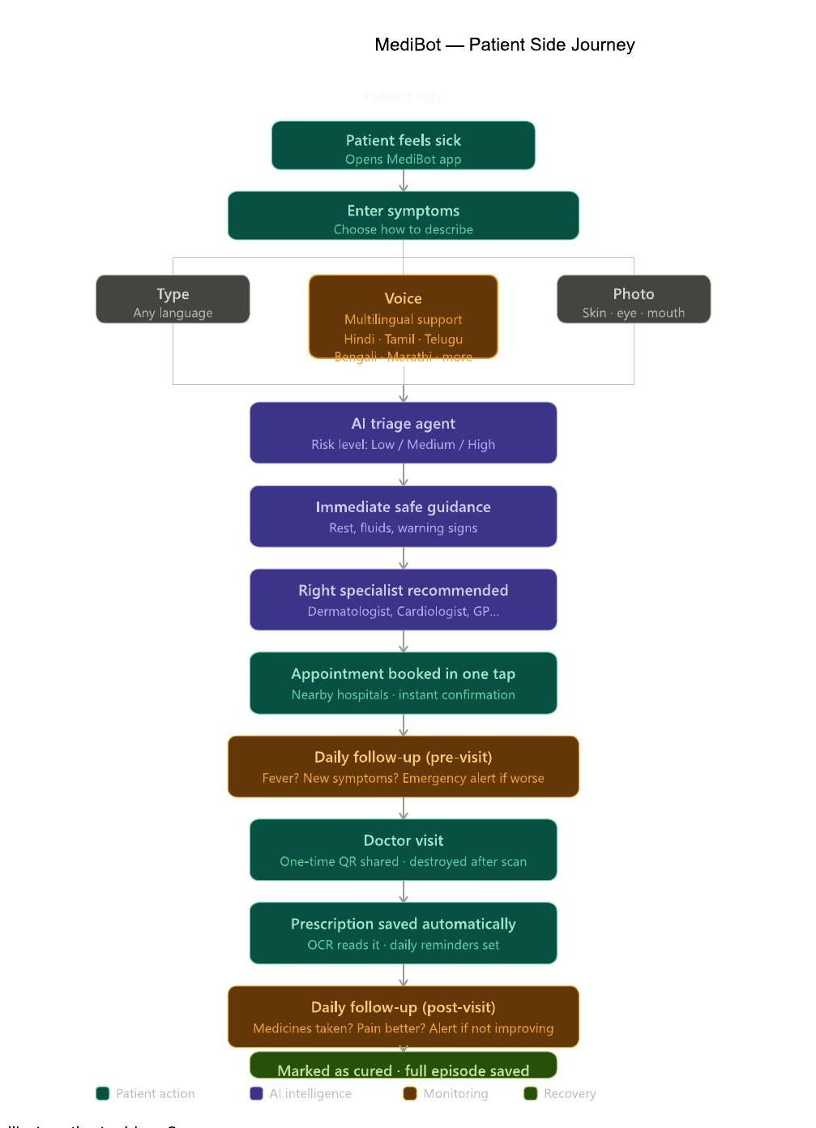
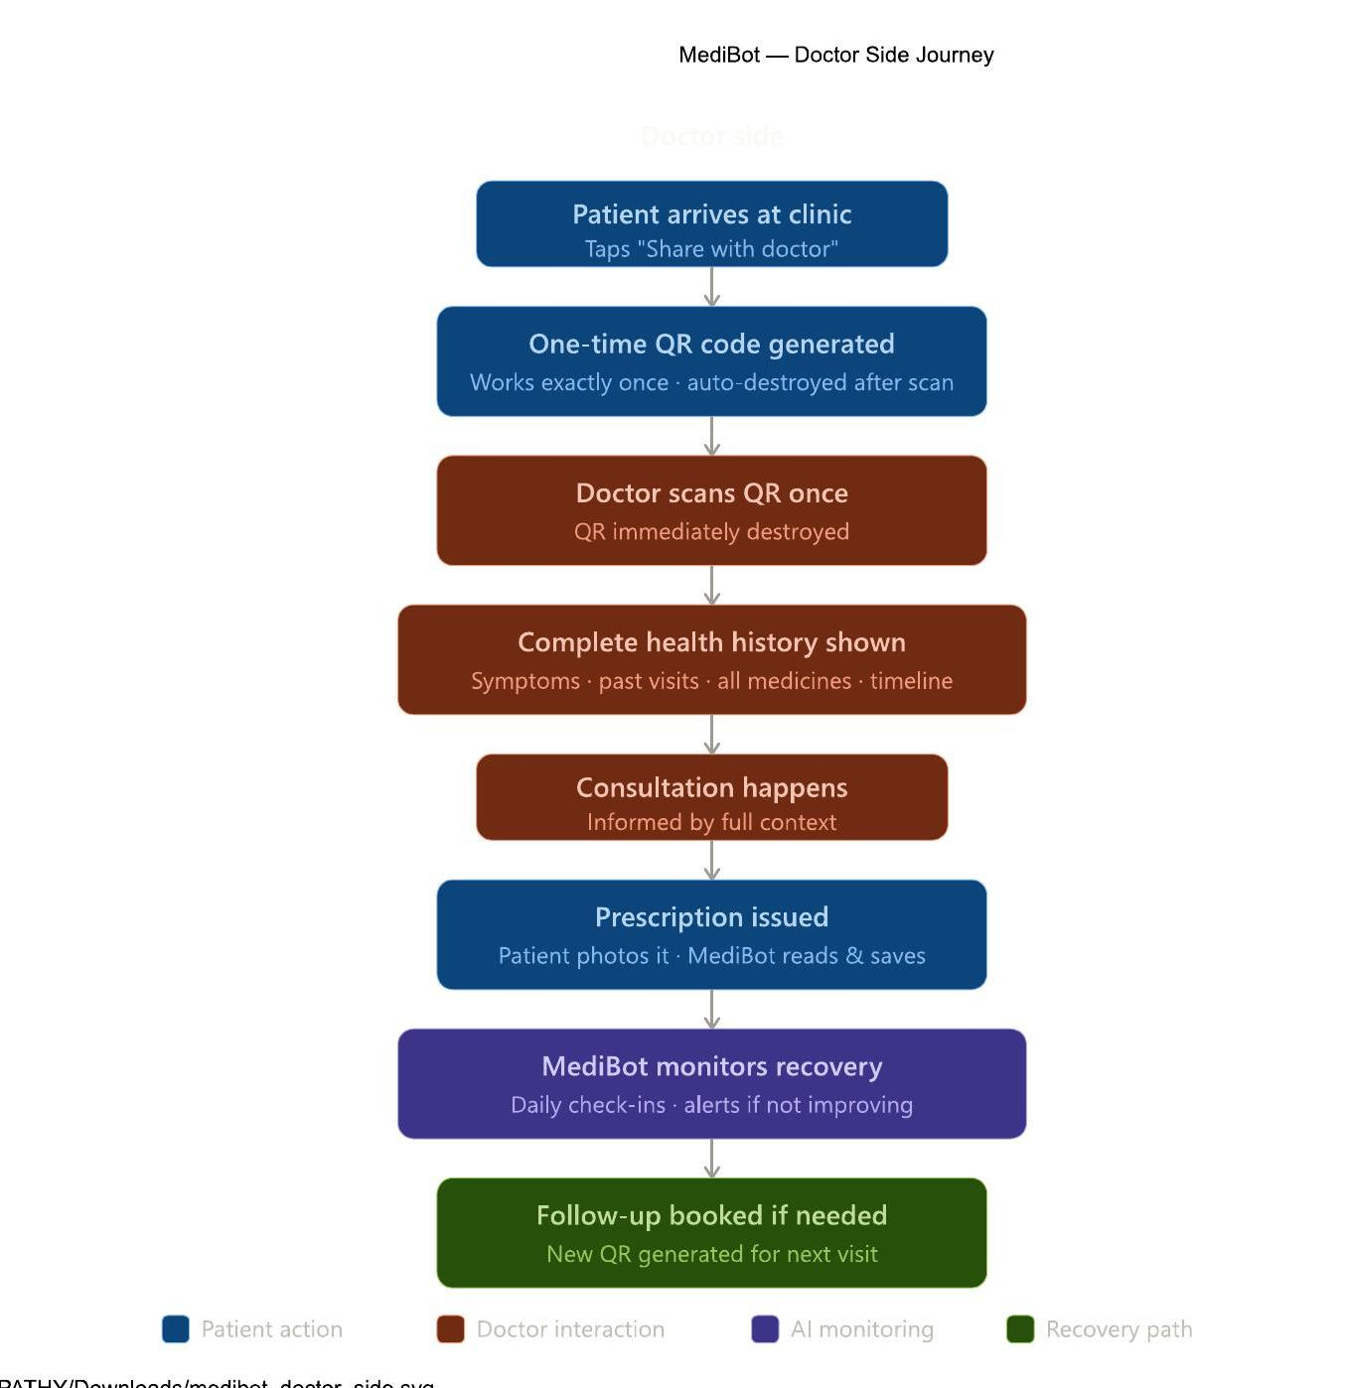
Technical Design and architecture
Technical Design and architecture
** Use additional slides to include other relevant details, as required.

Slide 7
<<Idea Title>>
Scalable / Reusable
Roadmap
Real-World Deployment Scope:
Fully serverless — scales from 1 to 10 million patients without infrastructure changes
DynamoDB on-demand billing: pay only for actual usage (₹0 when idle)
Lambda auto-scales to handle traffic spikes (e.g., monsoon season skin issues)
Multi-region deployment possible with single config change
Ease of Configuration for Other Businesses:
Other skin diseases: Change Bedrock prompts to cover psoriasis, eczema, fungal infections — no code changes needed
Other medical specialties: Replace "Dermatologist" with "Ophthalmologist" or "ENT" — same architecture works
Hospital chains: White-label the doctor portal for Apollo, Fortis, or government PHCs
Insurance companies: Integrate triage data for claim pre-authorization
Pharma companies: Medicine compliance tracking data for clinical trials
Phase 1 (Current MVP — Hackathon):
✅ AI skin triage (photo + text + voice)
✅ Multilingual support (EN/HI/TA)
✅ Appointment booking
✅ QR destroy-on-scan
✅ Daily monitoring with escalation
✅ Doctor portal
Phase 2 (3 months):
Mobile app (React Native) for Android/iOS
WhatsApp bot integration for rural patients
Integration with real hospital APIs (Apollo, Practo)
ABDM (Ayushman Bharat Digital Mission) health record linking
Phase 3 (6 months):
Expand to 5 more skin diseases (eczema, psoriasis, fungal, vitiligo, urticaria)
AI-powered treatment outcome prediction
Telemedicine video consultation integration
Regional language expansion (multilingual)
Phase 4 (12 months):
B2B SaaS for hospital chains
Insurance pre-authorization integration
Clinical trial patient matching
Government PHC deployment (Ayushman Bharat)

Slide 8
Our Technoverse Journey
Our team INSPIRA from KIT started with a simple observation: our college friends from rural Tamil Nadu would delay skin treatment for weeks because the nearest dermatologist was 50km away. We asked — what if AI could provide immediate guidance in Tamil?
We built MediBot in 18 hours using Amazon Kiro as our AI development partner. Kiro's spec-driven workflow helped us design the architecture before writing code, and its steering rules ensured consistent quality across 16 Lambda functions.
The "aha moment" was when we tested the Hindi symptom input — Claude generated culturally relevant advice like "neem paste application" alongside modern medical guidance. That's when we knew this could genuinely help millions.
Key stats from our build:
16 Lambda functions deployed
7 DynamoDB tables
16 API endpoints live
3 languages supported
Real AI-powered triage working end-to-end
Built entirely with Amazon Kiro + AWS services

Slide 9
Thank You Team INSPIRA KIT - Kalaingnar Karunanidhi Institute of Technology Rajaganapathi M | Divyasri M | Pradeep SA | Nivethika P

